Slide 1
Sub-Program

Slide 2
Content
Sub-program
- Introduction
- Type of sub-program
- Syntax
Goble and Local variable

Slide 3
Sub-Program
Also less memory is required to run program if funciton is used.
2
Introduction
Sub-program is a small program that can be executed in the other program.
Advantage of Sub-program
- It’s easy to test and determine the errors when coding doesn’t execute.
- Also less memory is required to run program if function is used.
- Helpful for team work
- Clear and readable

Slide 4
Also less memory is required to run program if funciton is used.
Sub-Program
Type of Sub-program
- Function: used to calculate something and has return value.
- Procedure: a set of commends executed in order and it has no return value.

Slide 5
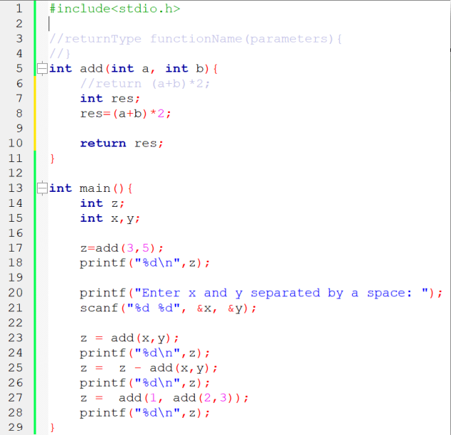
Also less memory is required to run program if funciton is used.
Sub-Program
Syntax in C program
- Function: is a set of instructions grouped under a name, that is called a subprogram and will return a value.
A function is a sub-program that:
Has a name
Can have one parameter or more than one parameters (arguments)
Return a value in a certain type
Can have variables inside (that variable is called local variable)
Composed of instructions

Slide 6
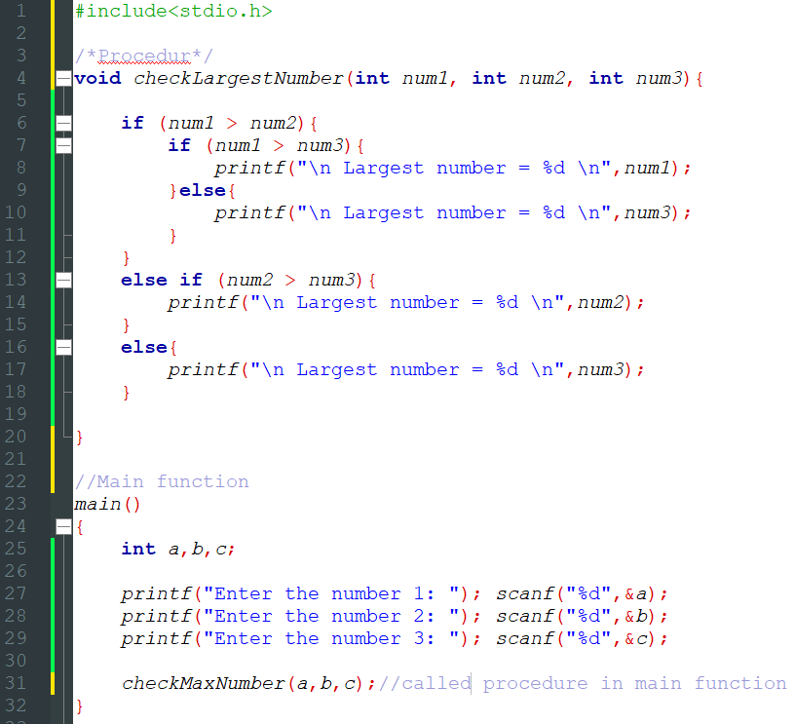
Also less memory is required to run program if funciton is used.
Sub-Program
Syntax in C program
- Procedure

Slide 7
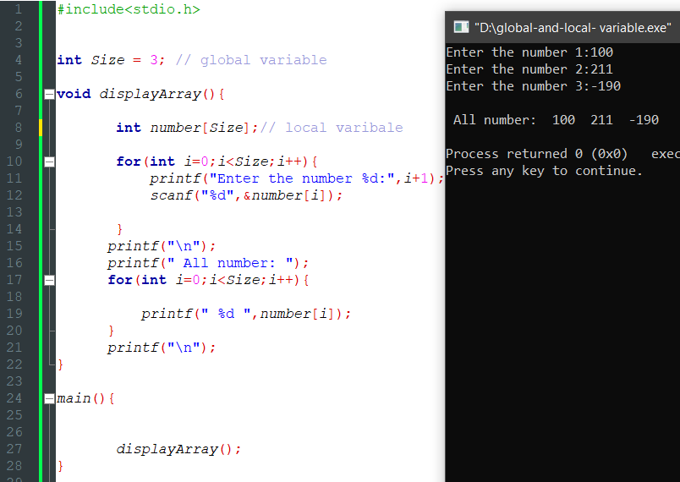
Also less memory is required to run program if funciton is used.
Goble and Local variable
Global variable
Global values are those variables created inside the main program
These variable can be accessed
from the other sub-program
Its value will be destroyed after
the whole program finish executing

Slide 8
Also less memory is required to run program if funciton is used.
Goble and Local variable
Local variable
Local variables are those variables created inside a sub-program
These variables can not be accessed
from outside the function
Its value will be destroyed after
the function finish executing

